Slide 1
Vaping & Legislation
Brad Barrett, Manny Ramos, Samantha Devlin, Tim Tallent

Slide 2
Motivation & Summary
“How has legislation on E-cigarettes changed smoking habits?”
Why did we ask this?
Hypothesis
(HA) Hypothesis: The adoption of Anti-E-cigarette legislation by states has a direct impact to reducing the percentage of adult E-cigarette users.
(Ho:) Null: The adoption of Anti-E-cigarette legislation by states does not have a direct impact on reducing the percentage of adult E-cigarette users.
Notes:
vaping has been a hot topic lately

Slide 3
Questions & Data
“What states have the most legislation, how did that effect smoking habits?”
Data Sources:
CDC STATE System E-Cigarette Legislation - Tax U.S. Department of Health & Human Services — 1995-2020
Centers for Disease Control and Prevention (CDC)
State Tobacco Activities Tracking and Evaluation(STATE) System
E-Cigarette Legislation—Tax
Behavioral Risk Factor Data:
Tobacco Use (2011 to present)Survey Data 2011-2018
Centers for Disease Control and Prevention (CDC)
State Tobacco Activities Tracking and Evaluation (STATE) System
BRFSS Survey Data

Slide 4
Data Cleanup & Exploration
Describe the exploration and cleanup process
Discuss insights you had while exploring the data that you didn't anticipate
Discuss any problems that arose after exploring the data, and how you resolved them
Present and discuss interesting figures developed during exploration, ideally with the help of Jupyter Notebook
Race
Legislation
% of E-Cig smokers
Tax
Focused by state

Slide 5

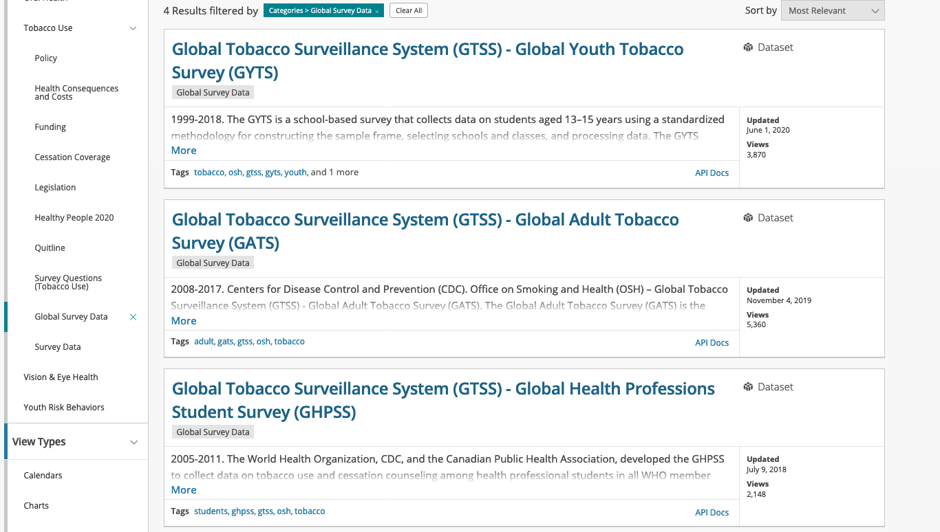

Slide 6
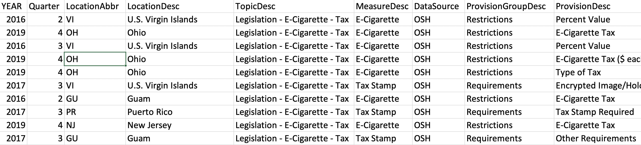
CDC E-Cigarette Legislation by State
State
Type of legislation/regulation
Provisions
Year legislation/regulation were active

Slide 7
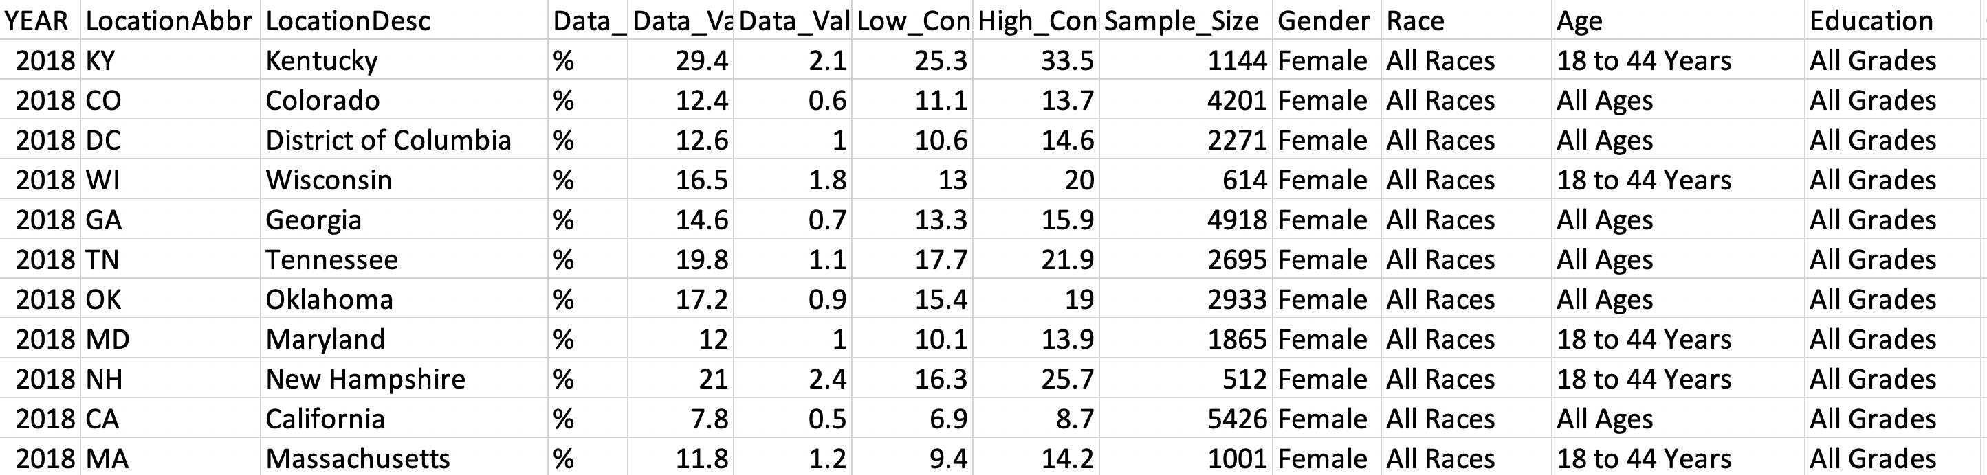
Demographics
State
Age
Race
Method of use

Slide 8
Data Analysis
Planned Analysis : We are going to compare the adult usage rate of the population data to sample data of states with high levels of Anti-E-cigarette legislation to determine statistical significance
Secondary Analysis : If correlation is determined between high legislation states, then we will determine which forms of legislation are more effective.

Slide 9
Discussion
States with the most legislation has the “_____” amount of e-cigarette smokers.

Slide 10
Post Mortem
What difficulties did we have?

Slide 11


Questions?

